Slide 1
Georg Fischer Senior Research Associate Vienna Institute for International Economic Studies, Fm. Director for Social Affairs, European Commission
fischer@wiiw.ac.at

Slide 2
The Pandemic: social impacts, inequality, policy challenges and recent EU initiatives
Inequality moved up at the EU Agenda as Social Divergence returned in the aftermath of the Great Recession: The European Pillar of Social Rights;
Pandemic highlights pre-existing social and labour market challenges;
National response fairly forceful … massive innovation at EU level .. Temporary or Policy shift ?
EU level social policies;

Slide 3
Where do we come from: starting points differ
Recent years relatively favourable development after high social and employment costs of the Great Recession reinforced by austerity:
Renewed Social Divergence between EU South and Core,
Credibility problems: banks were saved but not people,
Great Recession made a long term trend towards rising inequality visible that characterised in fact 2-3 decades before;

Slide 4
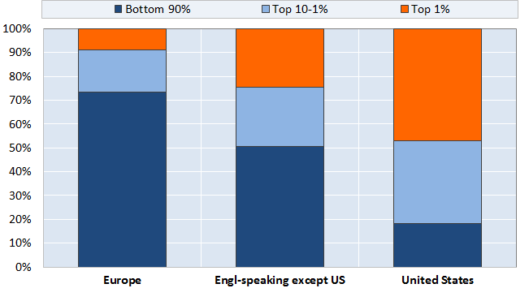
1975-2007: most of growth captured by top income groups then comes Great Recession with massive income loss;
Share of income growth going to income groups from 1975 to 2007
Source: OECD 2014, Focus on Top Incomes and Taxation in OECD Countries: Was the Crisis a Game Changer? (http://www.oecd.org/els/soc/OECD2014-FocusOnTopIncomes.pdf), Based on World Top Income Database.
Note: Incomes refer to pre-tax incomes, excluding capital gains

Slide 5
Convergence and Divergence: Unemployment 1995 -2015
Source: Eurostat, April 21 euro area 8.%, (7.3) EU 7,3 (6.7)

Slide 6
Unemployment Rates 2019 vs 2012 Improvements everywhere - levels differ widely

Slide 7
Recent Income Inequality trends: high in South, lower in Core, little change – new thinking needed;

Slide 8
IMF MD Kristalina Georgieva (fm VP EC):
Tackling inequality requires a rethink …
First, …Progressive taxation is a key component At the top of the income distribution, our research shows that marginal tax rates can be raised without sacrificing economic growth.
Second, social spending policies are increasingly relevant in tackling inequality. When done right they can play a fundamental role to mitigate income inequality and … social cohesion.
Add wages and collective bargaining – and we have the three main instruments to address inequality and poverty;

Slide 9
The Covid 19 Pandemics accelerates the demand for action on the social dimension
EU and countries react this time differently to Great Recession – again spending for banks and big firms but also massive income support for workers, self-employed and small firms;
Job retention measures moderate employment impact for many workers and households – 40 % of all workers - supported by national schemes (co-funded by new EU Scheme SURE)
Hence: Limited increase in unemployment and rapid decline in hours worked
But Precarity becomes more visible:
Atypical workers … 800.000 minijobs lost in DE
Women workers and their double burden;
Young people risk being left behind;
Inadequate income support for the unemployed;

Slide 10
Job Retention Measures: “Kurzarbeit”
Massive reduction in lay offs and little rise in open unemployment (compared to Great Recession);
Debate on longer term impacts of job retention:
How pertinent are Zombie firms really?
Impacts on workers …
US EU comparison points to
risks in terms of withdrawal from labour force despite generous income support in USA, l
lower job dynamics in Europe: Zombie firms and jobs?
What comes after job retention: re-training, move to other activities;

Slide 11
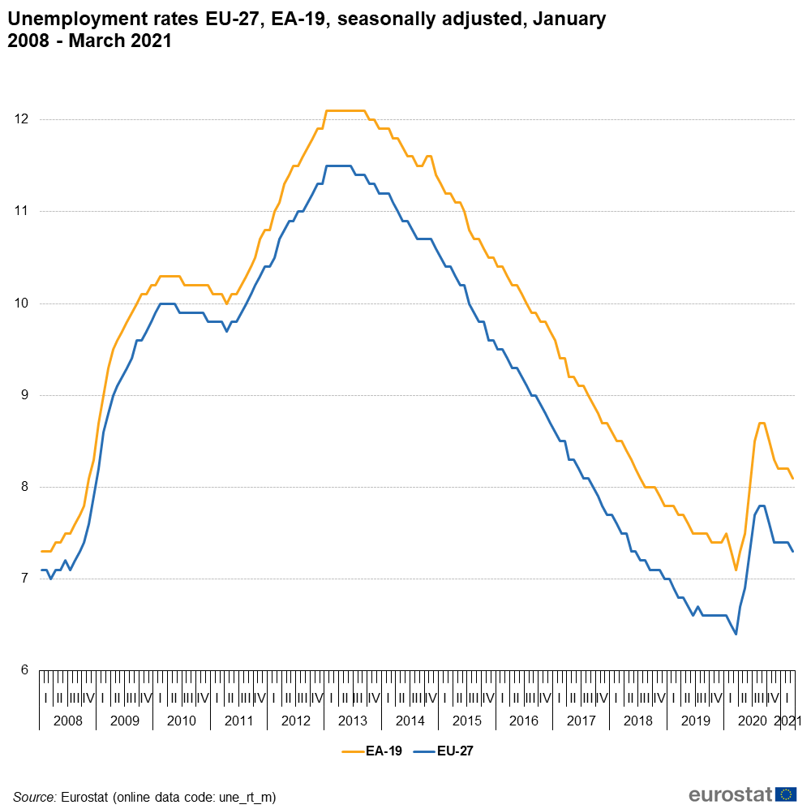

Slide 12
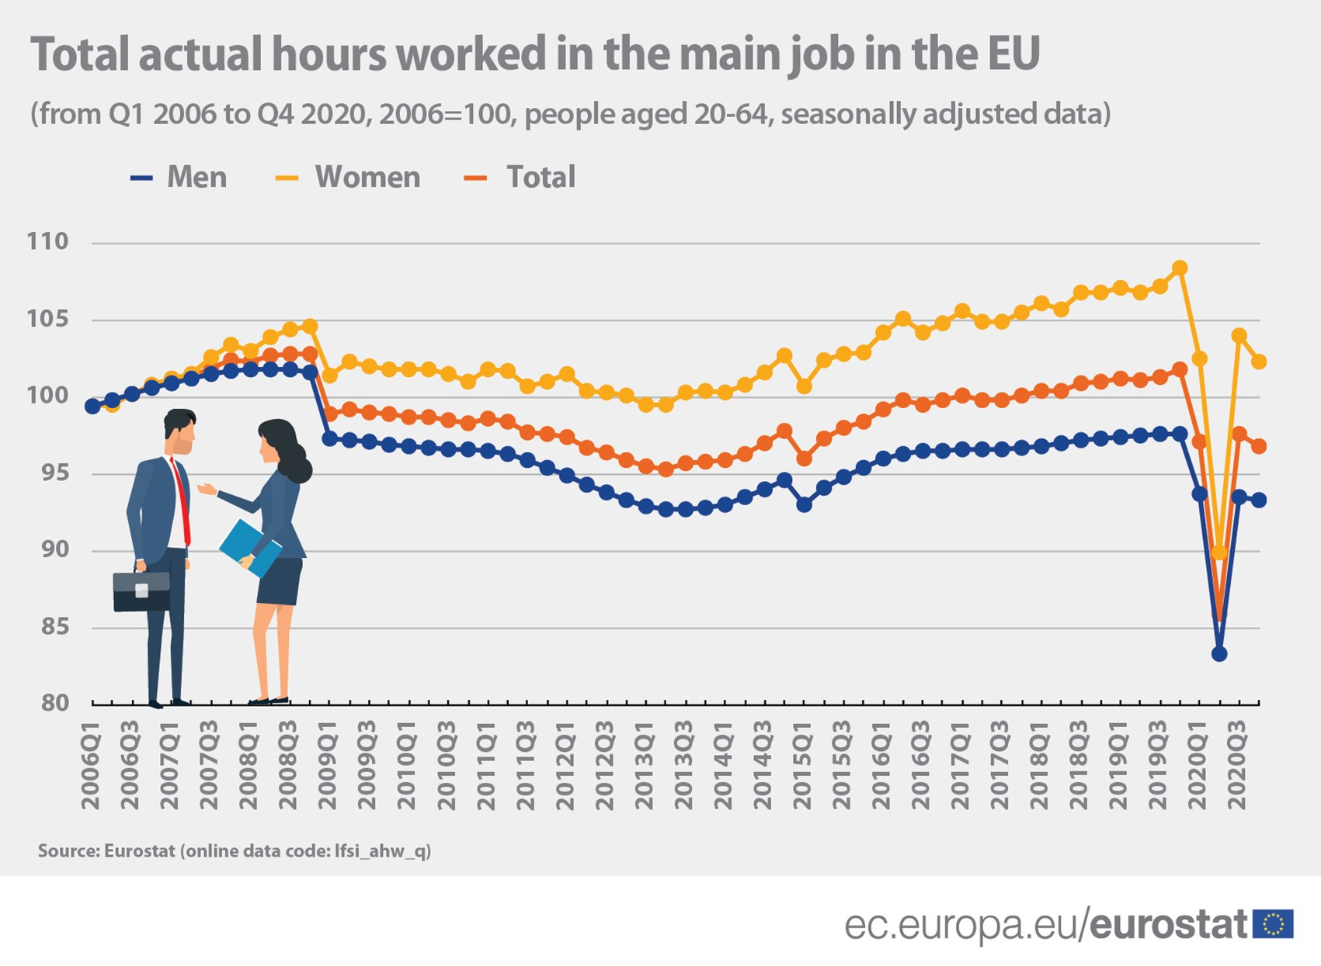

Slide 13
Activity rate EU and US women and men

Slide 14
Covid 19 crisis: Who risks being left behind:
Unemployed,
Temporary workers
Young people
Working carers … mostly female

Slide 15
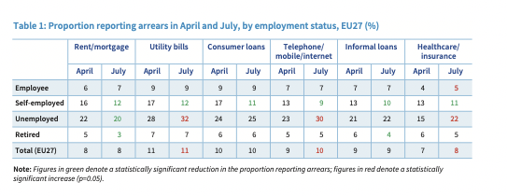
Who reports financial difficulties: the unemployed, atypical workers and self-employed without employees;
Eurofound July Survey

Slide 16
And increases pressure on working women

Slide 17
A Step Backwords: Young people neither in education, employment nor training (NEETS) And young women: EU 15,4 (14,6) ES 17,3 (15,4) IT 25,3 (24,3) PL 17,3 (16,6) TK 40,8 (40,8)
 | 2013 | 2017 | 2019 | 2020
EU 27 | 16,1 | 13,7 | 12,6 | 13,7
DE | 8,7 | 8,5 | 7,6 | 8,6
Greece | 28,5 | 21,3 | 17,7 | 18,7
Spain | 22,5 | 16,4 | 14,9 | 17,3
France | 13,8 | 13,8 | 13,0 | 14,0
Italy | 26,0 | 24,1 | 22,2 | 23,3
Hungary | 18,4 | 13,3 | 13,2 | 14,7
Poland | 16,2 | 12,9 | 12,0 | 12,9
Portugal | 16,4 | 10,6 | 9,2 | 11,0

Slide 18
National and EU Response to Covid Crisis
EU lifts budgetary restrictions on national budgets ... 4-5% EU GDP fiscal, 25% GDP guarantees and liquidity support
EU recovery plan for Europe 750 + 1040 bn (Budget);
ECB monetary support essential,
ESM 240 bn less used .. Bad reputation from past,
EIB 200 bn for enterprises,
SURE: 100 bn 2020/21: “support for workers not only banks” (Spanish VPM Calvino) reach around 30 (40) Million workers;
(corresponds to ESF+ over 7 years);

Slide 19
EU policy developments, pillar, Porto Summit - Important Initiatives:
Porto Summit = The Social Side claims a stake in EU Policies:
New Targets (employment, adult education, poverty):
Employment 78% ER + half gender gap, reduce NEETS,
Adult Education 60 target (37%) very ambitious for many countries, indicators point to low educated and unemployed;
Poverty and Social Exclusion reduce by 15 Million and 5 Mio childen … indicators refer to poverty gap and 40% SDG,
Review Barcelona target on ECEC;
Reinforcing Youth Guarantee, New Child Guarantee;

Slide 20
And important legislative initiatives
Minimum wage and Collective Bargaining,
Rights of Platform Workers,
Gender Violence including at work,
Recommendation on Minimum Income,
Implement Work-Life Balance Directive;

Slide 21
Porto Summit: the Glass is ….. ?
Porto: Social Rights to be included in Recovery Plans and European Semester: How strong a policy priority will be addressing causes of rising or high inequality in Recovery Plans?
Prospects for a permanent EU social programme (as UI or SNAP in USA)
VdL Commission started with a commitment to EU-UI reinsurance followed up with SURE programme;
Commission administers SURE and Recovery Programme (both massive interest in markets) and announces a review of SURE;
Draghi, Calvino demand: continue and transform SURE,
Other less supportive … Frugals and CDU election manifesto:
Are EU social programmes now more acceptable?

Slide 22
Thank You for Attention
Comments, Questions, Answers?

